Slide 2
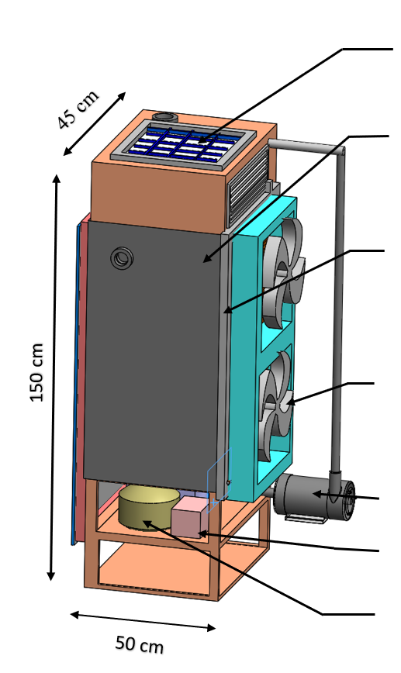
Solar Panel
Cooler Housing
Cooling Pad Holder
Propeller Fan
Water Pump
BMS Unit
Compressor

